Slide 1
Family violence
Family violence is the physical, sexual, psylogical, emotional, economic, spiritual and legal abuse of a family member. It is an illegal and unacceptable act.
Family violence can happen between:
Adults family members. This is the abusive for example between spouse or between adult children and parents.
Former adult family members. This is the violence for example between divorce spouses.
The family member who is violent is called perpetrator versus the victim.
It is sometime referred to as domestic violence or domestic abuse.

Slide 2
Fact about family violence
according to (Traoma,2011) about 1.6 million people loses their life as a result of family violence.90% of this death occurring in developing countries. The financial cost of violence translates into billions of US dollars . This is the expenditure in seeking healthy attendance as a result of injuries from this violence.
Some countries like Mozambique enhance laws against family violence

Slide 3
Myths about family violence (FV)
1. a slap never hurt anyone. The reality about family violence is that it can occur once or be build as time goes by. A physical abuse can lead even to the death of the victim.
2. Abused people enjoy it and they do not stay in the relationship. It is very hard to leave an abusive relationship
3.family violence is restricted to poorly educated families
4.only heterosexual women are battered.
5.FV is the crime committed by men to against women only.
6. domestic violence affect certain social class of people

Slide 4
Myths about family violence (FV)(cont..)
7. domestic violence is a social problem
8. alcoholic and drug abuse is not primary cause of family violence.
9. perpetrator is mentally unstable

Slide 5
Realities about family violence (FV)
Domestic violence is experienced in all social class and economic classes.
Many acts committed in FV is infraction of the criminal code.
Certain characteristics of relationship equals family violence. They may include; control over personal life, isolation as well as fear.
There is no provocation in sexual harassment . No situation is liable of the act.
Excessive consumption of alcohol and drug and substance is the main primary cause of family violence.

Slide 6
(cont…) Realities about family violence (FV)
6. although some abusive people have mental problem , family violence is no explained by illness.
7. complex factors can explain why victim can stay in violent relationship. Such includes defend of the children and over dependency among others.
8. battling is very common. It is one of the frequently repotted crime.

Slide 7

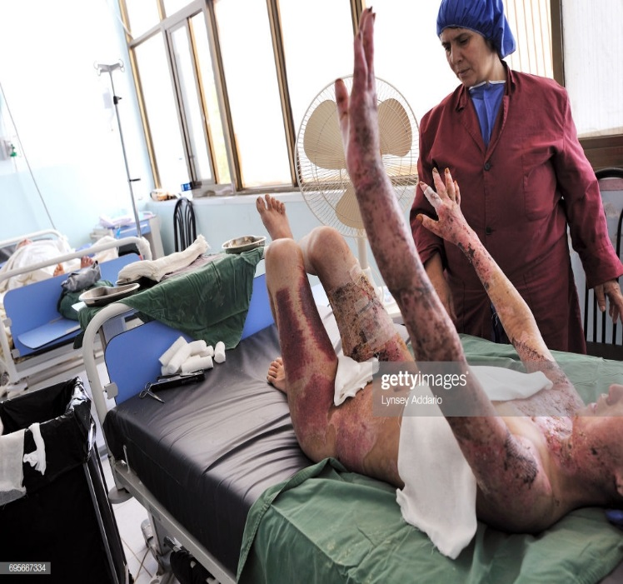
Images

